Slide 1


Santosh Verma
22-05-2023

Slide 2

Outline
Executive Summary
Introduction
Methodology
Results
Conclusion
Appendix

Slide 3
Executive Summary
This Capstone Project implemented methods for Data Collection, Data Scraping, Exploratory Data Analysis, Folium Maps, Making Dashboard and finally implementing various classifier models for prediction on SpaceX test data
We observed that with fine tuning of hyper-parameters we can improve the overall accuracy score of classification models.
Machine Learning models could accurately predict the launch outcomes displaying its capabilities which may help in growing business in various important aspects.

Slide 4
Introduction
In this capstone, we will predict if the Falcon 9 first stage will land successfully. SpaceX advertises Falcon 9 rocket launches on its website, with a cost of 62 million dollars; other providers cost upward of 165 million dollars each, much of the savings is because SpaceX can reuse the first stage. Therefore, if we can determine if the first stage will land, we can determine the cost of a launch
This information can be used if an alternate company wants to bid against SpaceX for a rocket launch. Instead of using rocket science to determine if the first stage will land successfully, we will train a machine learning model and use public information to predict if SpaceX will reuse the first stage.

Slide 5

Section 1

Slide 6
Methodology
Executive Summary
Data collection methodology:
In this capstone project, we will be working with SpaceX launch data that is gathered from an API, specifically the SpaceX REST API. This API will give us data about launches, including information about the rocket used, payload delivered, launch specifications, landing specifications, and landing outcome. The SpaceX REST API endpoints, or URL, starts with api.spacexdata.com/v4/.
Perform data wrangling:
We used to get request using requests library to obtain launch data from API. Our response will be in json format. To convert this JSON to a dataframe, we can use the json_normalize function. This function will allow us to “normalize” the structured json data into a flat table.
Perform exploratory data analysis (EDA) using visualization and SQL
Perform interactive visual analytics using Folium and Plotly Dash
Perform predictive analysis using classification models.

Slide 7
Data Collection
The SpaceX REST API endpoints, or URL, starts with api.spacexdata.com/v4/. We used it to target a specific endpoint of the API to get past launch data. We used get request using requests library to obtain launch data from API. Our response will be in json format. To convert this JSON to a dataframe, we can use the json_normalize function. This function will allow us to “normalize” the structured json data into a flat table form.
Another popular data source for obtaining Falcon 9 Launch data is web scraping related Wiki pages. We implemented the Python BeautifulSoup package to web scrape some HTML tables that contain valuable Falcon 9 launch records. Further we parsed the data from those tables and converted them into a Pandas data frame for further visualization and analysis

Slide 8
Data Collection – SpaceX API
1.SpaceX API to get past launch data
2. Import requests library to parse data from API or URL which will be in json format.
3. Use json_normalize() to convert json format response into flat tables
GitHub –
https://github.com/santo-mantras/IBM_CapstoneProject.git
Flowchart of SpaceX API calls
spacex_url=spaceX API
response = requests.get(spacex_url)
json_normalize(response)

Slide 9
Data Collection - Scraping
We implemented the Python BeautifulSoup package to web scrape some HTML tables that contain valuable Falcon 9 launch records. Further we parsed the data from those tables and converted them into a Pandas data frame for further visualization and analysis
GitHub –
https://github.com/santo-mantras/IBM_CapstoneProject.git
Flowchart of Web Scraping
spacex_url=spaceX wikipage
response = requests.get(spacex_url)
soup.find_all(“table”)

Slide 10
Data Wrangling
1. Identify and calculate the percentage of
the missing values in each attribute.
2. Calculate the number of launches on
each site.
3. Calculate the number and occurrence of
mission outcome per orbit type.
4. Create a landing outcome label from
Outcome column i.e., 1 for success and 0
for failure.
GitHub -
https://github.com/santo-mantras/IBM_CapstoneProject.git
Flowchart of Data Wrangling
df.isnull().sum()/df.shape[0]*100
df['LaunchSite'].value_counts()
df['Outcome'].value_counts()

Slide 11
EDA with Data Visualization
Graphs Plotted using seaborn as sns and matplot.pyplot as plt library
1. Scatter Plot (sns.catplot) : to observe if there is any relationship between launch sites and their payload mass.
2. Bar Chart (plt.bar) : to visually check if there are any relationship between success rate and orbit type.
3. Line Plot (sns.lineplot) : x axis as ‘Year’ and y axis to be average success rate, to get the average launch success trend.
GitHub - https://github.com/santo-mantras/IBM_CapstoneProject.git

Slide 12
EDA with SQL
SQL queries implemented –
1. ‘Select’ query to fetch the required rows from the table.
2. Select sum(Payload_mass) and avg(Payload_mass) to display total payload mass and avg payload mass.
3. Select Date query for displaying Dates from SpaceX table.
4. Select Count query to list the total number of successful and failure mission outcomes.
5. Using Sub queries to perform complex function like listing names of booster versions which have carried the maximum payload mass.
GitHub - https://github.com/santo-mantras/IBM_CapstoneProject.git

Slide 13
Build an Interactive Map with Folium
We used Folium for Interactive visual analytics following are some key attributes –
1. folium.Map : with an initial center location to be NASA Johnson Space Center at Houston.
2. folium.Circle : to add a highlighted circle area with a text label on a specific coordinate.
3. folium.marker : to Mark all launch sites on a map.
4. folium.icon : customize the Marker's icon property to indicate if launch was success or failed.
5. folium.PolyLine : to create a marker with distance to a closest city, railway, highway etc. and draw a line between the marker to the launch site.
GitHub - https://github.com/santo-mantras/IBM_CapstoneProject.git

Slide 14
Build a Dashboard with Plotly Dash
We have implemented Plotly Dash application to create Dashboard and perform interactive visual analytics on SpaceX launch data in real-time.
This dashboard application contains input components such as a dropdown list and a range slider to interact with a pie chart and a scatter point chart.
Following are the important elements of Dashboard –
1. Launch Site Drop-down Input Component.
2. A callback function to render success pie chart based on selected site dropdown.
3. A Range Slider to Select Payload.
4. A callback function to render the scatter plot.
GitHub - https://github.com/santomantras/IBM_CapstoneProject.git

Slide 15
Predictive Analysis (Classification)
1. Building the Model -
Performed exploratory Data Analysis to determine training labels.
Created a column for the class as ‘0’ for fail and ‘1’ for successful launch.
Standardize the data and Split into training data and test data.
2. Evaluation and Improvement -
Finding best Hyperparameter for SVM, Classification Trees and Logistic Regression and the method which performs best using test data.
GitHub - https://github.com/santo-mantras/IBM_CapstoneProject.git
Flowchart of Model Improvement
Fine tune the model using hyperparameters
Evaluate Model on test data
Finding Best Hyperparameters

Slide 16
Results
Exploratory Analysis Results comprises of different plots and screenshots which are mentioned from Section - 2, Section-3 and Section-4 of this presentation.
Interactive analytics demo in screenshots is also provided from Section-2 onwards.
Predictive analysis results are provided in the final section i.e., Section-5 of this presentation that consist of prediction accuracy, confusion matrix of different models that are implemented on our Space X dataset.

Slide 17

Section 2

Slide 18
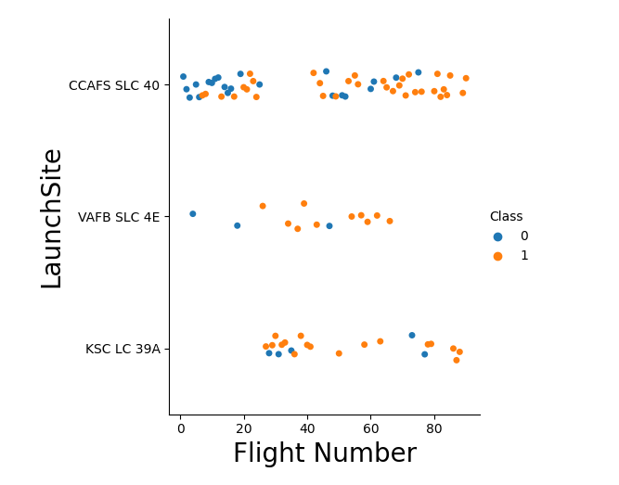
Flight Number vs. Launch Site
Scatter plot of Flight Number vs. Launch Site is shown.
Class 0 indicates a failed launch and 1 indicates a successful launch.
We can observe that there are much more launches from launch site CCAFS SLC 40 followed by launch site KSC LC 39A. However, the launch site VAFB SLC 4E has highest successful launches when compared to other launch sites.

Slide 19
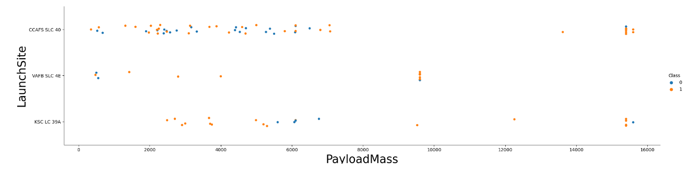
Payload vs. Launch Site (Scatter Plot)
Class 0 indicates a failed launch and 1 indicates a successful launch.
We observed that for VAFB-SLC launch site there are no rockets launched for heavy payload mass(greater than 10000 kg).

Slide 20
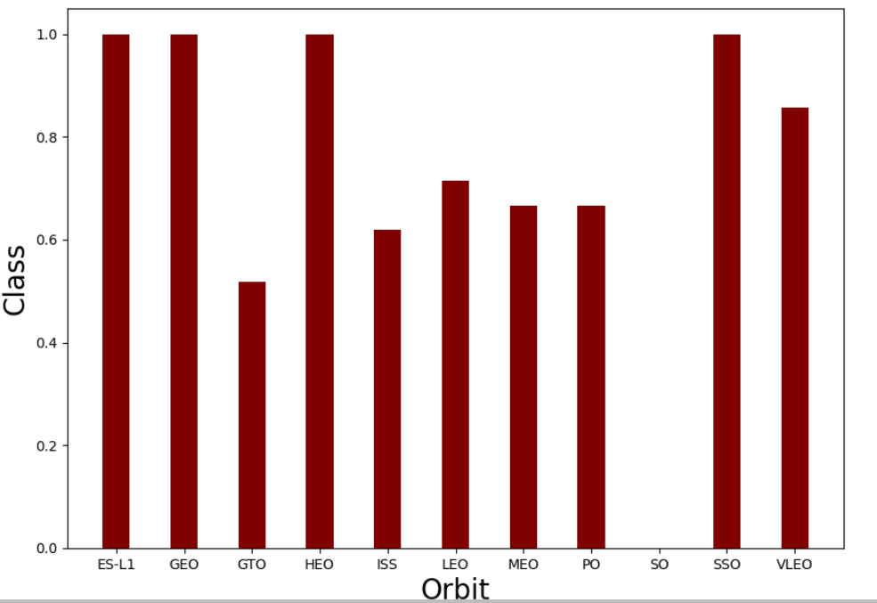
Success Rate vs. Orbit Type (Bar Chart)
Bar chart for the success rate of each orbit type is shown.
Class on Y axis here indicates mean value of class for each orbit type respectively.
We observed that launch sites – ES-L1 , GEO, HEO, SSO have highest success rate while GTO has lowest.
Orbit SO has no successful launch.

Slide 21
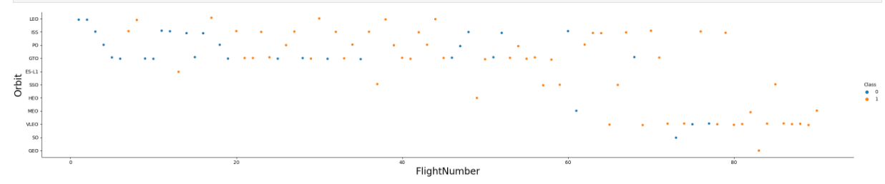
Flight Number vs. Orbit Type
Scatter plot of Flight number vs. Orbit type is shown.
We observed that in the LEO orbit the Success appears related to the number of flights; on the other hand, there seems to be no relationship between flight number when in GTO orbit.

Slide 22
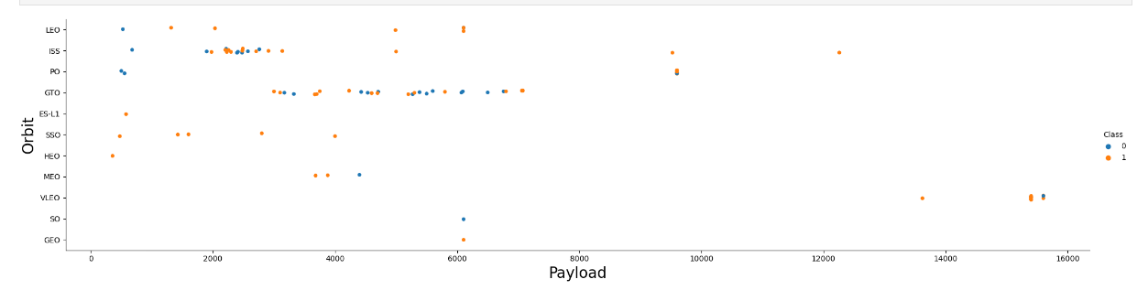
Payload vs. Orbit Type
Scatter plot of Flight number vs. Orbit type is shown.
We observed that with heavy payloads the successful landing or positive landing rate are more for Polar, LEO and ISS. However, for GTO we cannot distinguish this well as both positive landing rate and negative landing(unsuccessful mission) are both there here.

Slide 23
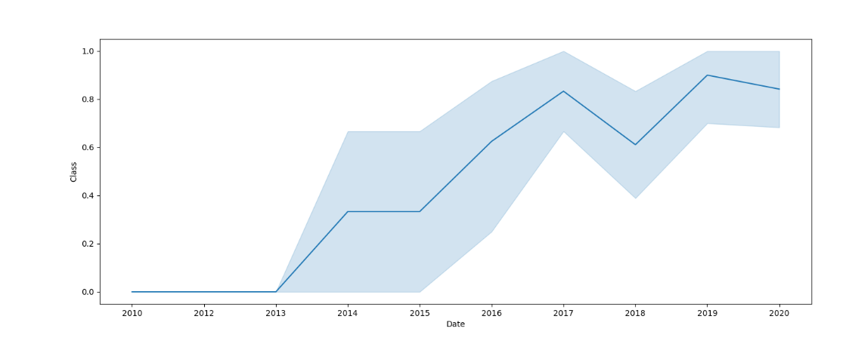
Launch Success Yearly Trend
A line chart of yearly average success rate is shown.
We can observe that the success rate since 2013 kept increasing till 2020.

Slide 24
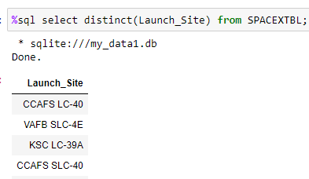
All Launch Site Names
Below is the SQL query and its result for listing out names of all unique launch sites –
We observed that there are 4 unique launch sites named as CCAFS LC-40, VAFB SLC-4E, KSC LC-39A and CCAFS SLC-40 respectively.

Slide 25
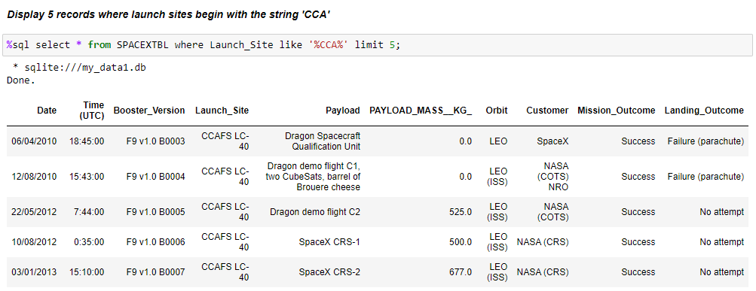
Launch Site Names Begin with 'CCA'
Below is the SQL query to display 5 records where launch sites name begin with ‘CCA’

Slide 26
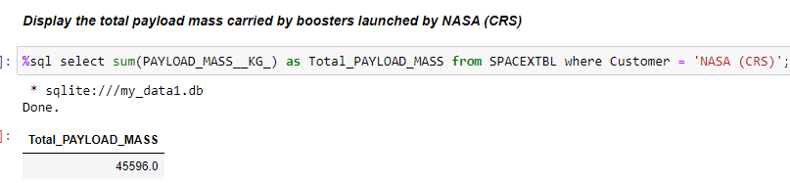
Total Payload Mass
Below is the SQL query and its result for finding out the total payload mass carried by boosters launched by NASA. We observed that the total payload mass values is 45596.0 kg.

Slide 27
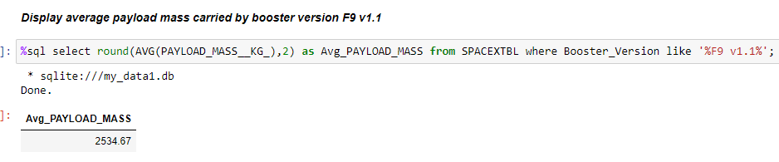
Average Payload Mass by F9 v1.1
Below is the SQL query and its result for finding out the average payload mass carried by booster version F9 v1.1. We observed that the average payload mass values is 2534.67 kg.

Slide 28
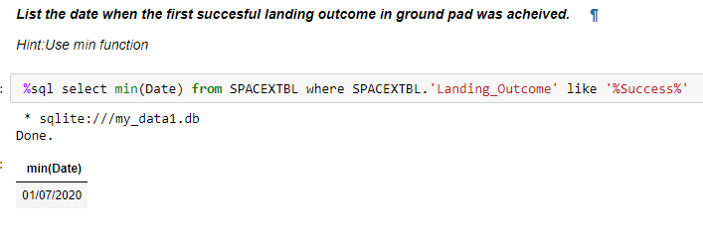
First Successful Ground Landing Date
Below is the SQL query and its result for finding out dates of the first successful landing outcome on ground pad. We observed that the date is - 01/07/2020

Slide 29
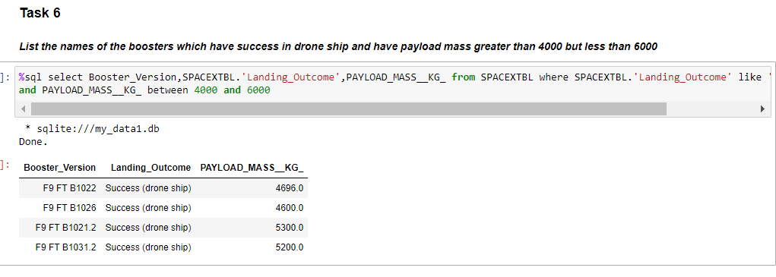
Successful Drone Ship Landing with Payload between 4000 and 6000
Below is SQL query and its result for displaying the names of boosters which have successfully landed on drone ship and had payload mass greater than 4000 but less than 6000.

Slide 30
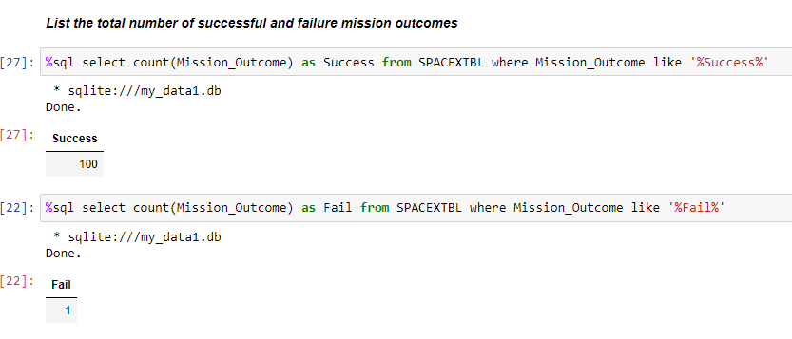
Total Number of Successful and Failure Mission Outcomes
From the SQL query and its results, we can clearly observe that there are 100 successful mission outcomes and 1 Failed mission outcome.

Slide 31
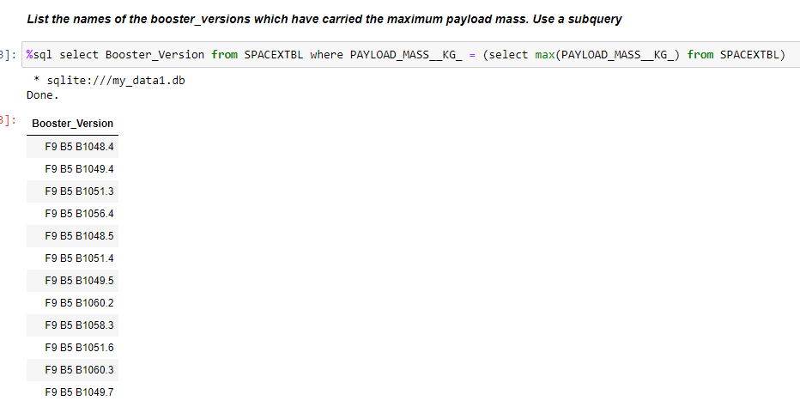
Boosters Carried Maximum Payload
Below is the SQL query and its result for the names of the booster which have carried the maximum payload mass

Slide 32
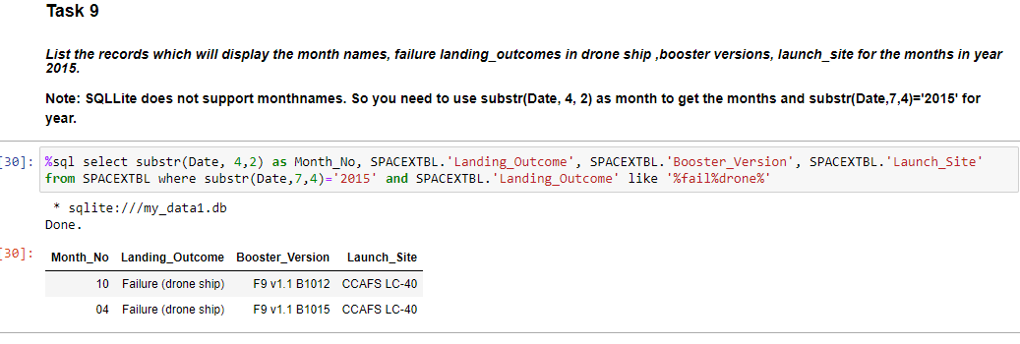
2015 Launch Records
Below is the SQL query and its result to find List of failed landing outcomes in drone ship, their booster versions, and launch site names for in year 2015. We observed that there are two failure in month of April (04) and October (10) respectively.

Slide 33
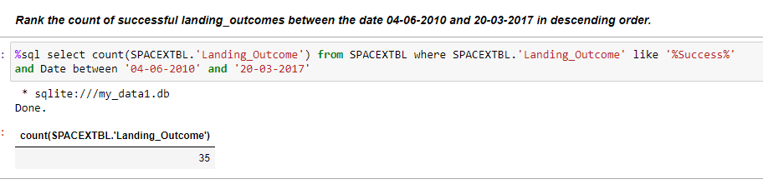
Rank Landing Outcomes Between 2010-06-04 and 2017-03-20
Below is the SQL query and its result to for Ranking the count of landing outcomes Success (ground pad)) between the date 2010-06-04 and 2017-03-20, in descending order.

Slide 34

Section 3

Slide 35
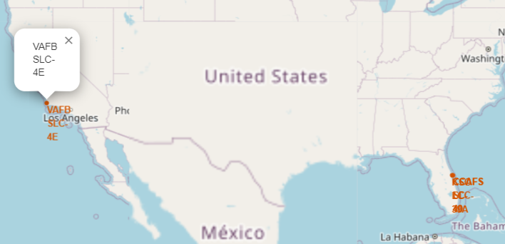
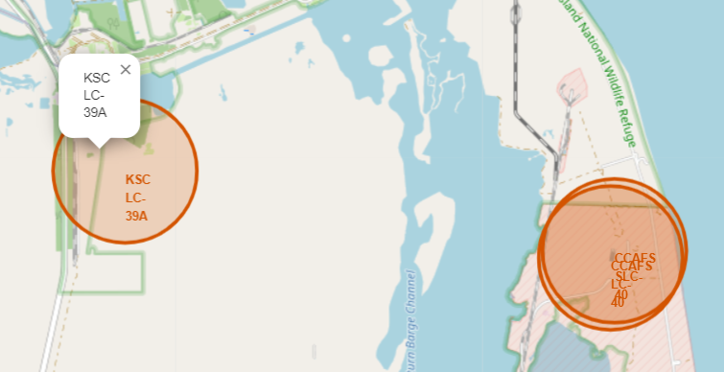
Folium Map Launch Site Location
Below is the screenshot of USA map displaying launch site locations in red marker locations. We can observe that these locations are near coastline one at east and other one at west border respectively.

Slide 36
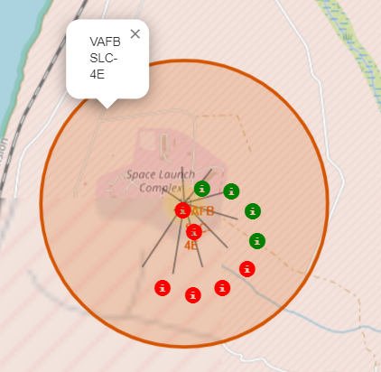
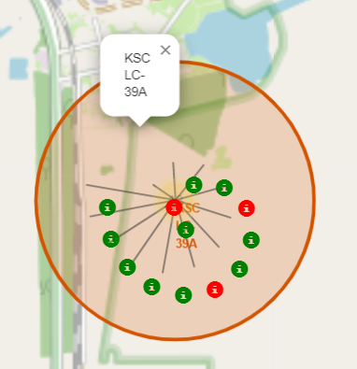
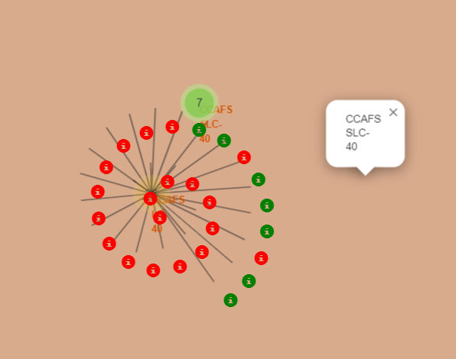
Folium Map Launch Outcomes
Below is the screenshot of Folium Map Launch Outcomes in red and green markers as displayed for different launch sites. Please note that Successful launches are marked with green color while red color markers are for failed launch outcomes.

Slide 37
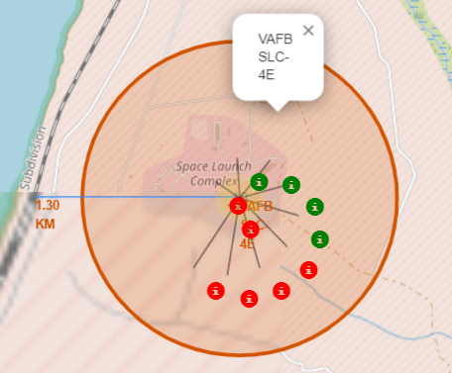
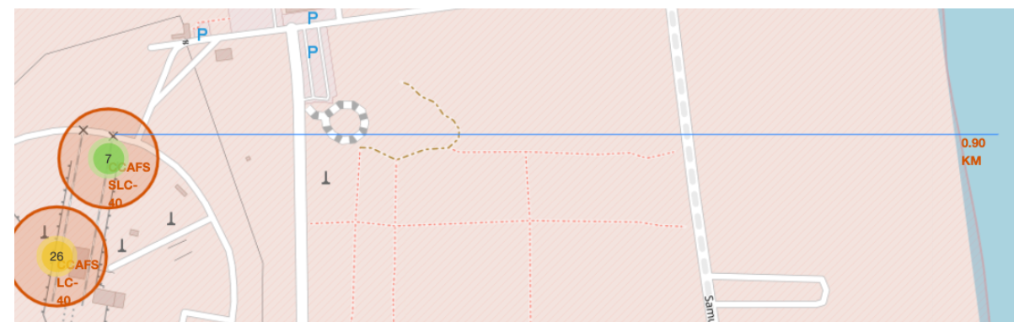
Folium Map Launch Site Proximities
1. Displayed screenshot of Folium Map Launch Site VAFB SLC - 4E close distance to railway line. We can observe that the distance is around 1.30 KM.
2. Displayed screenshot of Folium Map Launch Site CCAFS SLC - 40 close distance to coastline. We can observe that the distance is around 0.90 KM.

Slide 38

Section 4

Slide 39
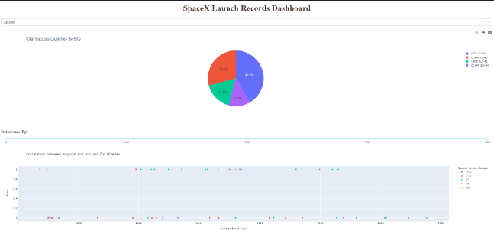
Dashboard Pie Chart of success launch count
Below is the screenshot of Dashboard Pie Chart displaying successful launch counts.

Slide 40
Dashboard Screenshot of Pie chart
Below is the screenshot of Dashboard Pie Chart displaying successful launch counts.

Slide 41
Dashboard Screenshot of Pie chart
Below is the screenshot of Dashboard Pie Chart displaying successful launch counts.

Slide 42

Section 5

Slide 43
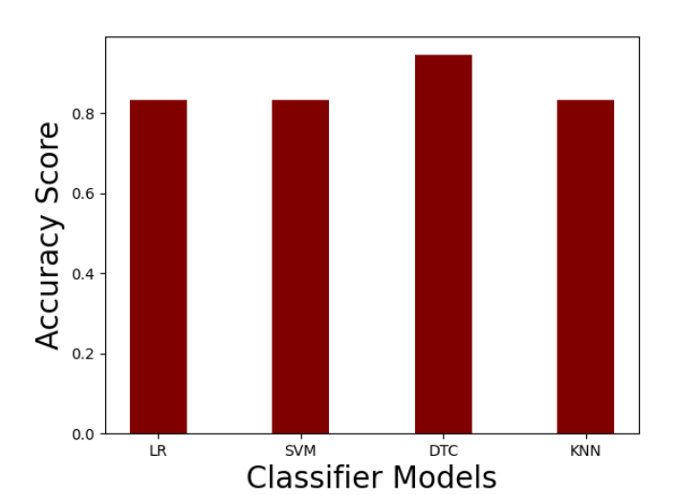
Classification Accuracy
In this Capstone project we have implemented 4 models for classification tasks – LR (Logistic Regression), SVM (Support Vector Machine), DTC (Decision Tree Classifier) and KNN (K-Nearest Neighbor).
Bar chart that represents prediction accuracy of all the 4 models is shown.
Kindly Note Standard Scaling method has been used for preprocessing the data.

Slide 44
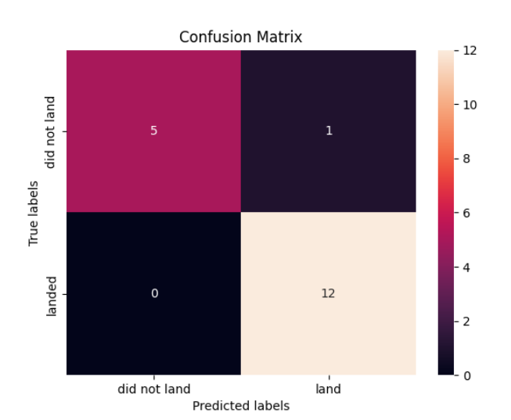
Confusion Matrix
From the Bar chart in previous slide we can observe that DTC (Decision Tree Classifier) Model has highest accuracy score of 0.94 among other classification models.
Confusion Matrix for DTC model is shown.
True Positive – 12 , False Positive – 1, True Negative – 5 , False Negative – 0
Recall Score – 1
Precision Score – 0.92
F1 Score – 0.9583

Slide 45
Conclusions
In this capstone project of SpaceX, we predicted if the Falcon 9 first stage will land successfully.
This information can be used if an alternate company wants to bid against SpaceX for a rocket launch.
From our data analysis and application of machine learning models we observed that Classifier models such as Logistic regression, SVM and KNN gave score of 83% accuracy which is a good score to build up the model further.
However, 83% accuracy is still not good enough in rocket launch business where heavy amount of money is involved. Hence, We tried another model and observed that DTC (Decision Tree Classifier) model is most effective in terms of predicting whether a landing will successful or not. The model has accuracy of 94 % on test data which is most promising and helpful in making important decisions in the business.

Slide 46
Appendix
GitHub Repository - https://github.com/santo-mantras/IBM_CapstoneProject.git
Other Resources -
TowardsDataScience - https://towardsdatascience.com
Analytics Vidhya - https://www.analyticsvidhya.com/blog/2021/05/in-depth-understanding-of-confusion-matrix/

Slide 47


